Slide 1

COMPARATIVE STUDY OF CRYPTOGRAPHY ALGORITHMS AND ITS APPLICATIONS BACHELOR THESIS DEFENSE PRESENTATION American International University Bangladesh

Slide 2
Members
LOREN JAFRIN ZAFAR ID: 14-25728-1
HASAN,MAHMUD ID:14-25874-1
HASAN,MD.MAHADE ID:14-25547-1
HOSSAIN,S.M.TANJIM ID-14-27037-2

Slide 3
Motivation
Our motivation of thesis work is to do the performance analysis of different algorithms of symmetric and asymmetric cryptography based on different performance metrics and network attacks which will help the researchers to identify the suitable algorithms for different types of applications.

Slide 4
Outline
INTRODUCTION
SYMMETRIC CRYPTOGRAPHY ALGORITHM
ASSYMETRIC CRYPTOGRAPHY ALGORITHM
PERFORMANCE ANALYSIS METRICS
COMPARISION OF SYMMETRIC AND ASSYMETRIC ALGORITHMS
DISCUSSION
CONCLUSION

Slide 5
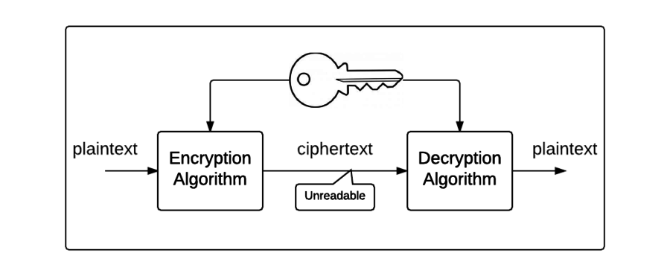
WHAT IS CRYPTOGRAPHY?
Cryptography is a process of translating the original plain text into cipher text.
When the data is sent to receiver as chipper text, then third party can’t access the data as the original form.
Cryptography is important because it allows us to securely protect data that we don't want anyone else to have access to.

Slide 6
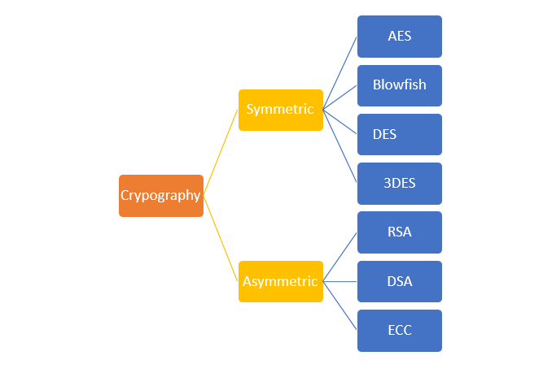
CRYPTOGRAPHIC ALGORITHMS

Slide 7
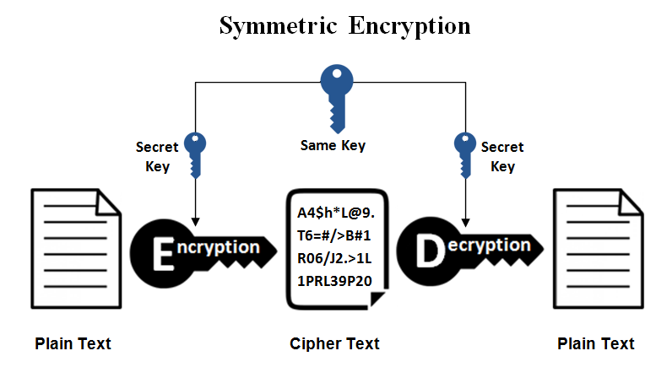
SYMMETRIC ALGORITHM
It uses a secret key that can either be a number, a word or a string of random letters. It is a blended with the plain text of a message to change the content in a particular way.
The sender and the recipient should know the secret key that is used to encrypt and decrypt all the messages.

Slide 8
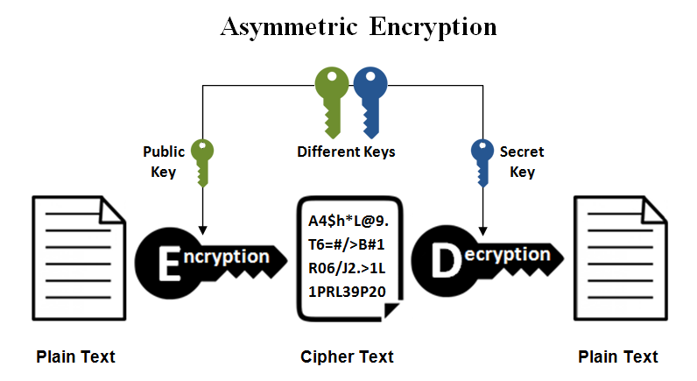
ASYMETRIC ALGORITHMS
Asymmetric encryption, or public key encryption uses what is called a key pair—a public key for encrypting a message, and a private key to decryption.
A public key is made freely available to anyone who might want to send you a message. The private key is kept a secret so that you can only know.

Slide 9
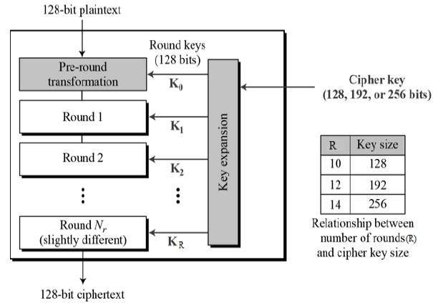
AES ALGORITHM
The Advanced Encryption Standard, or AES, is a symmetric block cipher.
Introduced by Rijndael in Oct-2000 and designed by Vincent Rijmen and Joan Daemen in Belgium.
AES comprises three block ciphers: AES-128, AES-192 and AES-256.

Slide 10
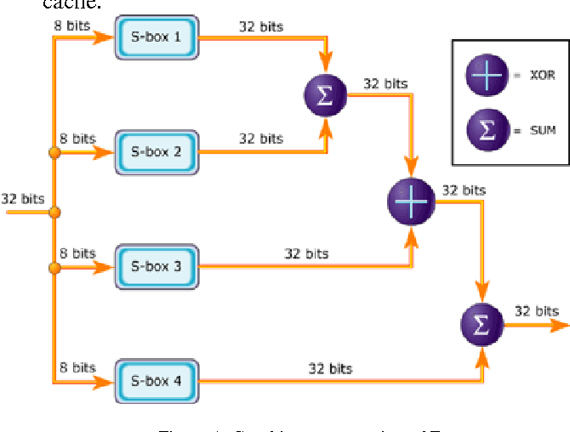
Blowfish algorithm
Designed in 1993 by Bruce Blowfish
Freely available ( Unpatented; Royalty- free, No license required; Free source code )
64-bit block cipher with variable length key
Large key-dependent S-boxes.
The key length is variable ,it can be in the range of 32~448 bits: default 128 bits key length.
Fast encryption ( much faster then DES)
Compact
Simple

Slide 11
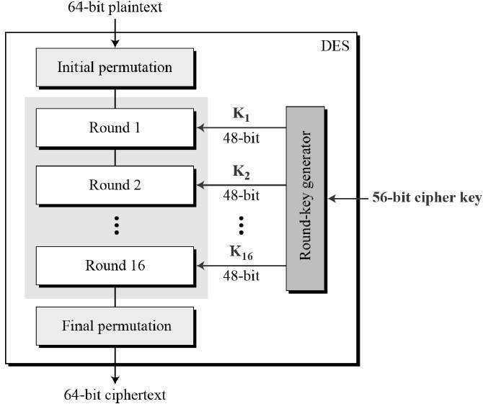
DES ALOGORITHM
Des (Data Encryption Standard) was developed in 1970 at IBM by Horst Feistel. This encryption standard was recommended by NIST (National Institute of Standards Technology)
DES consists of a 16-round series of substitution and permutation. Thus, data and key bits are shifted, permutated, XORed, and sent through 8 boxes, a set of lookup tables that are essential to the DES algorithm.
The basic process enciphering a 64-bit data block and a 56-but cipher key

Slide 12
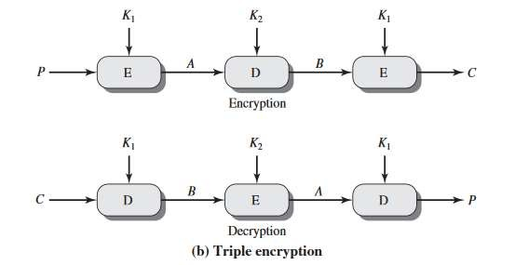
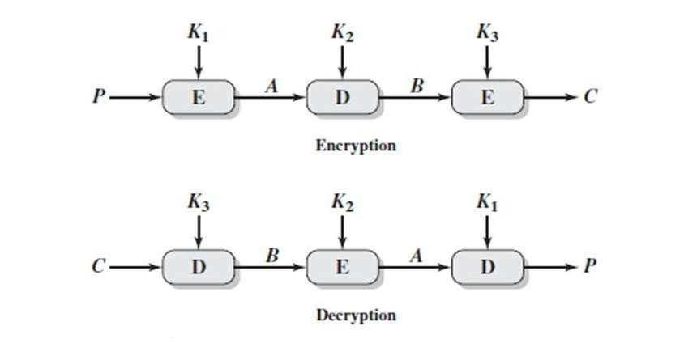
3DES ALGORITHMS
3DES was developed in 1999 by IBM by a team led by Walter Tuchman
3DES is the same thing except it encrypts the data 3 times and uses a different key for at least one of the passes
This creates a cumulative key size of 112-168 bits
Triple DES with 2-key
Triple DES with 3-key

Slide 13
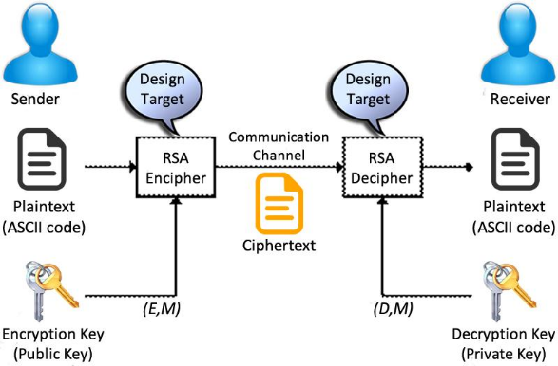
RSA ALGORITHM
Invented by Rivest/Shamir/Adelman (1978)
First asymmetric encryption algorithm
Most widely known public key cryptosystem
Used in many protocols (e.g., SSL, PGP, …)
Number theoretic algorithm: security based on difficulty of factoring large prime numbers
1024, 2048, 4096-bit keys common

Slide 14
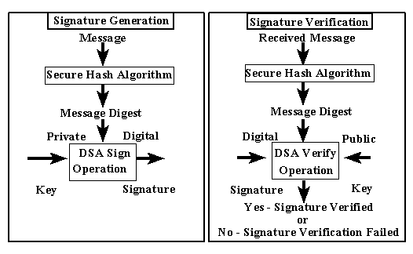
DSA ALGORITHM
DSA was proposed by the National Institute of Standards and Technology (NIST) in August 1991 for use in their Digital Signature Standard (DSS)
A digital signature is basically a way to ensure that an electronic document (e-mail, spreadsheet, text file, etc.) is authentic

Slide 15
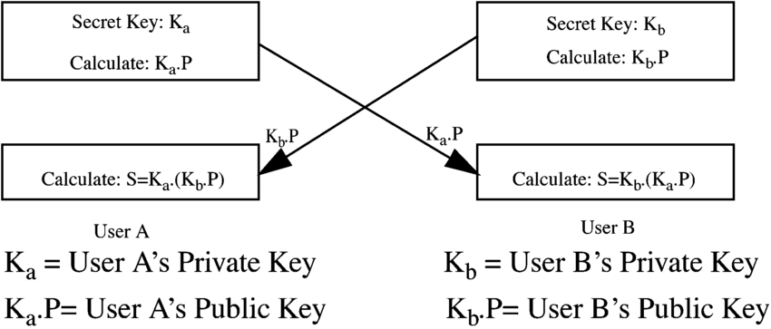
ECC ALGORITHM
Miller and Koblitz (independently) introduced elliptic curves into cryptography in the mid-1980s
Elliptic Curve Cryptography algorithms entered wide use between 2004 and 2005
Works on the basis of elliptic curves.
Elliptic curves work because they have a special property- one can add two points on the curve together and get a third points on the curve
Unless there is a breakthrough in math, ECC will continue ti be a good algorithm

Slide 16
PERFORMANCE METRICS
Key length: Key length is the number of bits in a key used by a cryptographic algorithm which determined the time complexity of transferring the data to the sender and receiver ends.
Block Size: A block is a sequence of bytes or bits, usually containing some whole number of records, having a maximum length, a block size. Data thus structured are said to be blocked.
Round: Round is a function, which measures how much time the operation needs to perform for retrieve data.
Vulnerabilities: Weakness points of a system which can be exploited by attacker.
Efficiency: Determines how fast or slow it behaves when implemented in hardware and software.
Applications: Performance area of algorithm with specific function directly for the user or, in some cases, for another application program.

Slide 17
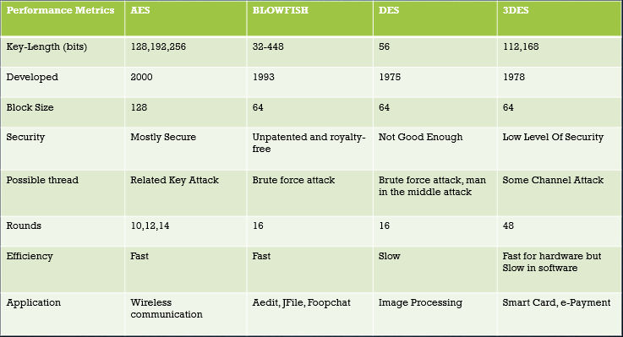
Performance analysis of symmetric Cryptography Algorithms

Slide 18
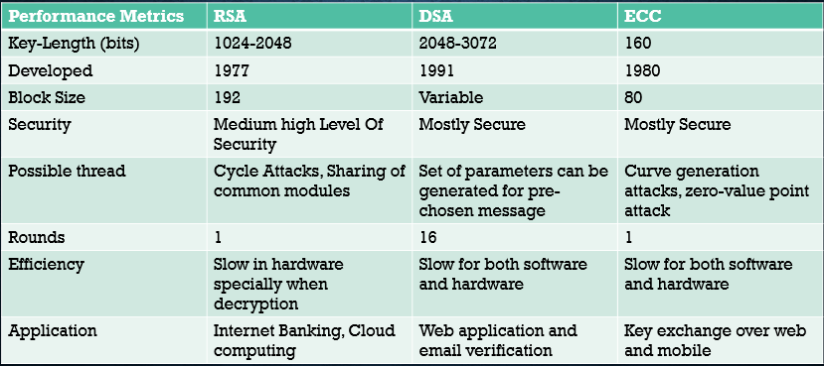
Performance analysis of Asymmetric Cryptography Algorithms

Slide 19
Conclusion
Although Symmetric and Asymmetric algorithms both are highly efficient for protecting the data in their own relevant field of data transferring but based on the result analysis and discussion we can conclude that symmetric cryptography algorithms.
AES, BLOWFISH, DES, 3DES are more suitable for the applications like wireless communication, Jfile, image processing, smart card or e-commerce type of serveries respectively.
RSA, DSA, ECC are the best options for the applications like Internet banking, web application, email verification, key exchange over web, mobile.

Slide 20
